Slide 1
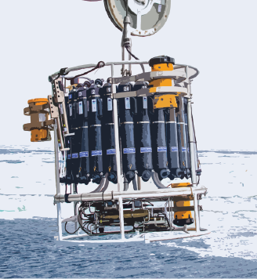
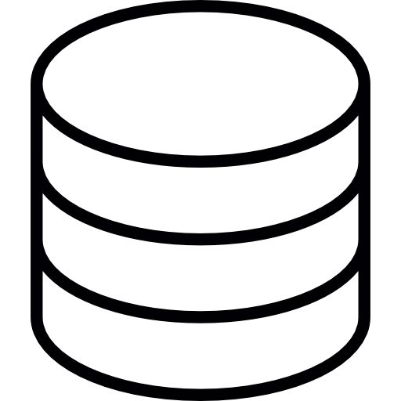
CTD PROCESSING TOOLS
MINI-WORKSHOP 12.12.23

Slide 2
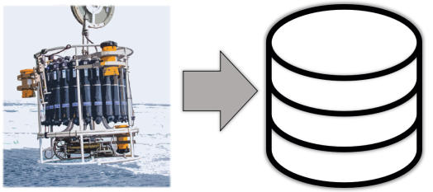
MINI-WORKSHOP
NOT INTENDED AS
An introduction to Python/GitHub/..
A detailed walkthrough of source code
Guide to HavNett documentation
Introduction to other in-house tools
Guide to contributing to code or documentation

Slide 3
MINI-WORKSHOP
NOT INTENDED AS
INTENDED AS
An introduction to Python/GitHub/..
A detailed walkthrough of source code
Guide to HavNett documentation
Introduction to other in-house tools
A minimal introduction to working in a Jupyter/xarray environment
A quick view into CTD processing tools from a user perspective
→ Starting point for discussion:
Is this useful?
Is it easy to use?
What can be made better?
What do we want the final files to look like?
Is the documentation ok?
What functionalities are missing?
Guide to contributing to code or documentation

Slide 4
MINI-WORKSHOP
10 min
Introduction to the rationale
5 min
Quick introduction to Jupyter/xarray framework
15 min
Tutorial and working example
15 min
Quick introduction to the CTD processing tools
30 min
Walkthrough, simple example
30 min
Test with your own data
20 min
Discussion

Slide 5
RATIONALE: THE DATA PIPELINE
Before scientific use
Conversion to physical values
Post-deployment calibrations, e.g.,
Compass heading corrections
Sound velocity corrections from observed water properties
Applying post-deployment lab or in-situ calibrations, ++
Visual QC and outlier editing
Combining datasets from different sensors
Contextual editing, e.g.,
Adjustment to hydrography, CTDs, tidal models e.g.
Open water corrections, ++
Before data publishing
Conversion to netCDF
Standardized metadata, e.g.,
Sensor details
Deployment details
Processing history
Quality indicators
Cross-referencing, licenses, contacts,
++
Often a laborious process!
Some degree of “reinventing the wheel”
Some degree og hard-coding for each dataset
Resource demanding → Delays the scientific work s and the publication of data
Often not frriendly to first-time users
Shared processing tools
ws
“Doing it well, once”
Pooling of knowledge, experience
Improved efficiency and quality

Slide 6
PROCESSING TOOLS
NOTE SIMPLIFY (USE SIMPLE VISUALS)
TECHNICAL PRINCIPLES
Starting point: Data converted to physical units using manufacturer software
Built in Python
Using the xarray.Dataset type
Developed for gridded geophysical data
Excellent metadata handling
Excellent integration with Jupyter
Integrates very well with netCDF
Made available on GitHub, eventually also on PyPi / conda
Libraries: Contain source code libraries
Interlinked modules/functions
Often quite large scripts
Typically not acessed directly by user (but should be well-structured to facilitate contribution)
Attempting to keep these generalized, i.e. not hardcoded for specific datasets
Should be version controlled and DOI’ed
Project templates: Contain template projects:
Project folder structure
Jupyter notebooks for running the code
Prompt user interaction where required
Tutorials
Conserve metadata across all operations!
Extensive documentation including examples and tutorials
Easy export and import to .csv, .mat, .netCDF
Comply with conventions (integrated convention checkers)
Better integration with data centers
Open-access, FAIR, open to contributions
GENERAL PRINCIPLES

Slide 7
JUPYTER / XARRAY
NOTE SIMPLIFY (USE SIMPLE VISUALS)
TECHNICAL PRINCIPLES
Starting point: Data converted to physical units using manufacturer software
Built in Python
Using the xarray.Dataset type
Developed for gridded geophysical data
Excellent metadata handling
Excellent integration with Jupyter
Integrates very well with netCDF
Made available on GitHub, eventually also on PyPi / conda
Libraries: Contain source code libraries
Interlinked modules/functions
Often quite large scripts
Typically not acessed directly by user (but should be well-structured to facilitate contribution)
Attempting to keep these generalized, i.e. not hardcoded for specific datasets
Should be version controlled and DOI’ed
Project templates: Contain template projects:
Project folder structure
Jupyter notebooks for running the code
Prompt user interaction where required
Tutorials
Conserve metadata across all operations!
Extensive documentation including examples and tutorials
Easy export and import to .csv, .mat, .netCDF
Comply with conventions (integrated convention checkers)
Better integration with data centers
Open-access, FAIR, open to contributions
GENERAL PRINCIPLES

Slide 8

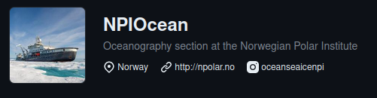
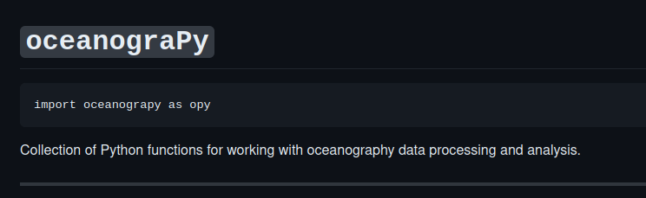
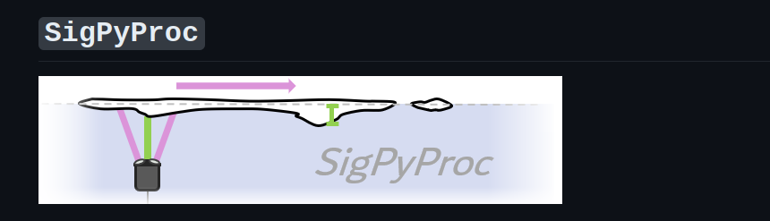
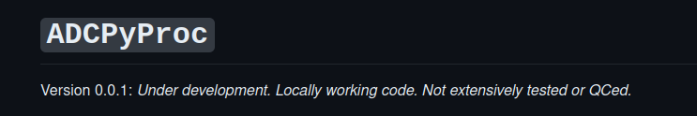
Libraries under development
Python tools for oceanographic data
Specific tools for parsing/processing/CF-formatting SeaBird CTD data
Eventually: Mooring CTD tools (SBE, RBR)
Tools for processing Nortek Signature instruments for ocean velocity and sea ice velocity and draft
Tools for processing RDI moored ADCPs for ocean velocity
Currently lives in various repositories (Public or Private

Slide 9
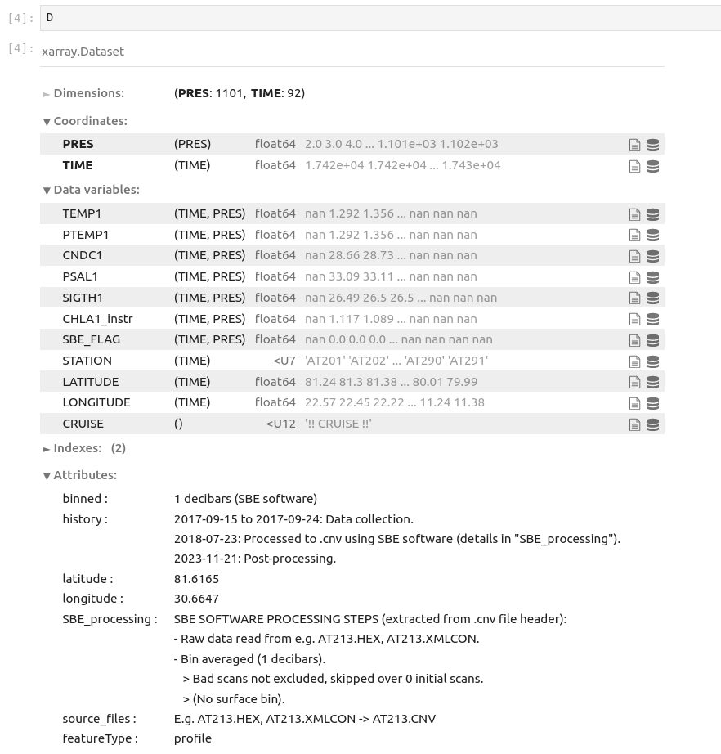
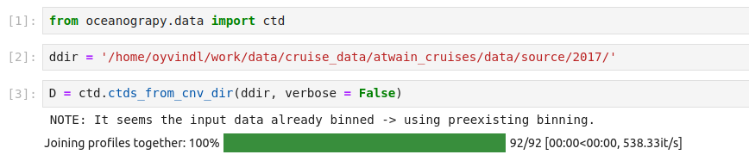
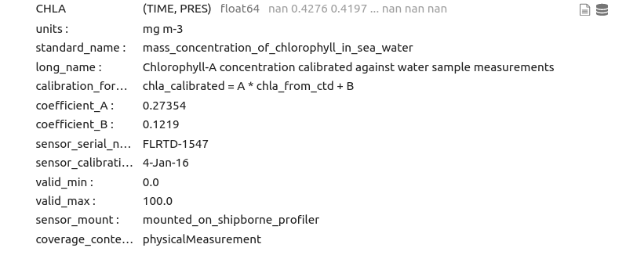
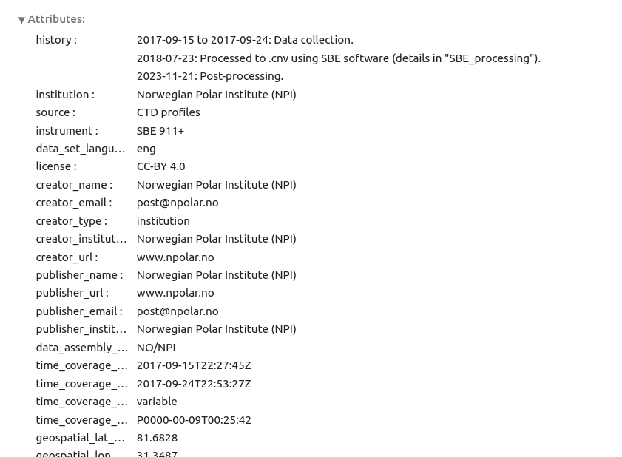
Example
Parse data/metadata and join profiles
Processing steps
Format for publication
Metadata checking functions

Slide 10
Status
Everything is under development!
Currently developing/testing/checking with different datasets
Code structure etc. is still changing - working on refactoring, packaging, and documentation
Planning to have beta versions for ship CTD (oceanograPy) and Nortek500 ice processing (SigPyProc) ready in early Jan at the latest
Making good progress on the basic functionality for
Ship CTD
.cnv to CF-compatible .nc functionality works well
TBD: QC/analysis/editing functions
TBD, eventually: Standardize reading from other formats (.mat) etc
Nortek Signature ADCP
Basic functionality works well
Work to do on testing/packaging/documentation and implementing standardized metadata.
RDI ADCP
Fairly comprehensive, but needs to be updated to the xarray/CF approach
Needs refactoring to xarray (currently class-based using numpy masked arrays)
Needs testing/packaging/docs

